Slide 1
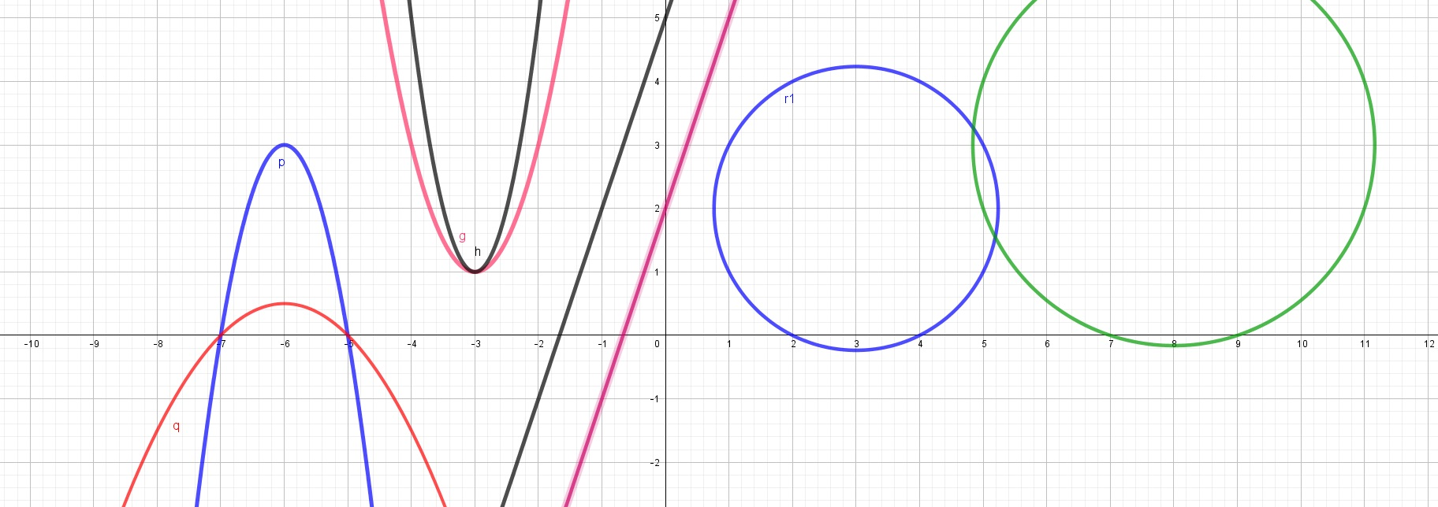
Conic sections (conics)
Filip Konopka

Slide 2
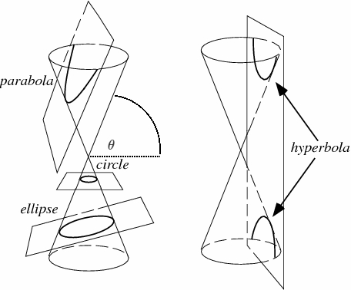
Conic sections
The conic sections are curves obtained by the intersection of a right circular cone and a plane. According to the angle of intersection the conic is an ellipse, a parabola or a hyperbola. A circle is also a conic – it‘s a special case of an ellipse.

Slide 3
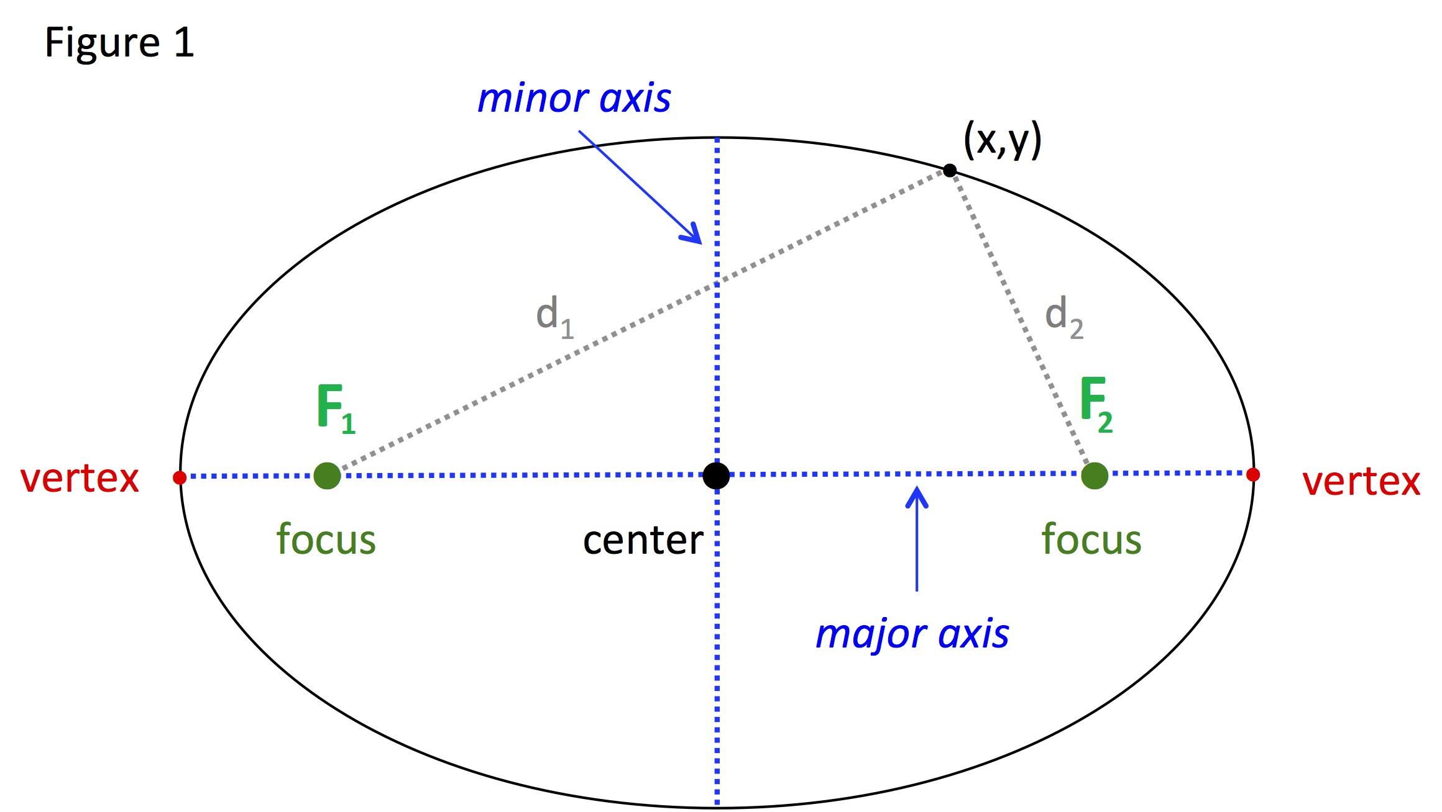
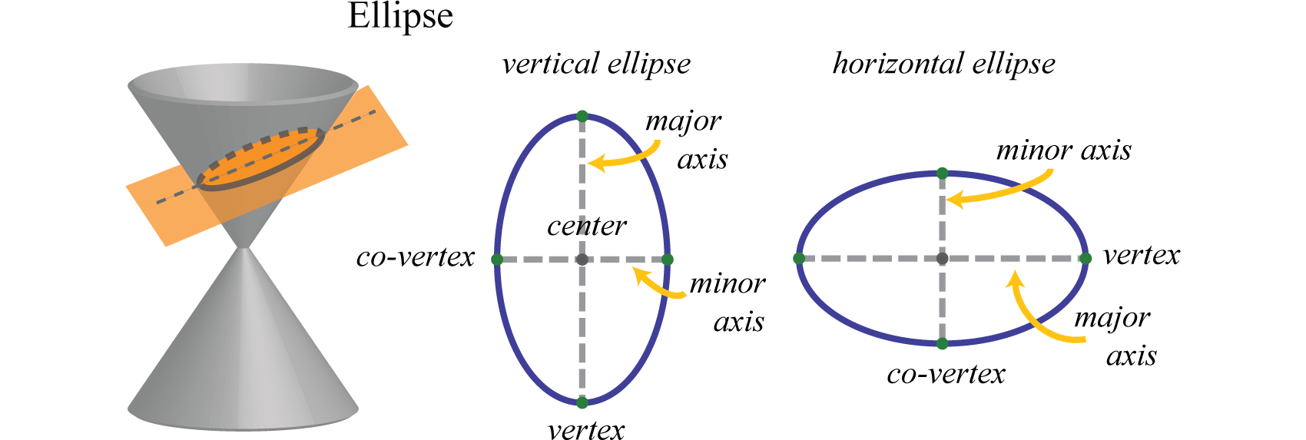
Ellipse
Ellipse is a closed curve which is symmetrical about both its axes.
Fixed points F1 and F2 are called foci of an ellipse.
The line segment through the foci is the major axis. Perpendicular to the major axis through the centr is the minor axis.
The points where the axes cut the ellipse are the vertices.
The midpoint of the vertices is the centre of the ellipse.

Slide 4
Ellipse
Given two fixed points F1, F2 called the foci and a distance 2a which is greater than the distance between the foci. The ellipse is the set of points P such that the sum of the distances |PF1| and |PF2| is equal to 2a.

Slide 5
Equations of ellipse
Point [x_0, y_0] is the centre of ellipse and a,b are length of axis.

Slide 6
$x^{2}+36y^{2}−1=0$ is equation of a real ellipse.
$x^{2}+36y^{2}+1=0$ is not equation of a real ellipse.

Slide 7
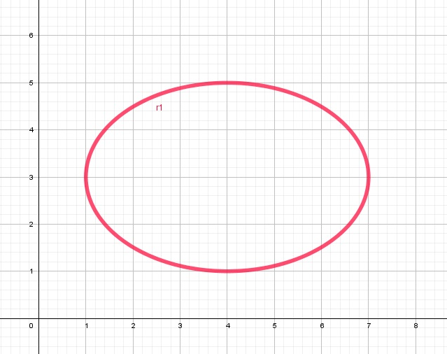
Tasks
Find the centre ot the ellipse.
Find the lengths of axis of this ellipse.
Find the equation ot this ellipse.

Slide 8
Tasks
Find the centre ot the ellipse.
Find the lengths of axis of this ellipse.
Find the equation ot this ellipse.
$$\frac{{(x−4)}^{2}}{9}+\frac{{(y−3)}^{2}}{4}=1$$

Slide 9
Tasks for students
Find the centre and vertices of the ellipse. Sketch the ellipse.
$$4x^{2}+25y^{2}=100$$

Slide 10
Tasks for students
Find the centre and vertices of the ellipse. Sketch the ellipse.
$$4x^{2}+25y^{2}=100$$
$$\frac{x^{2}}{25}+\frac{y^{2}}{4}=1$$

Slide 11
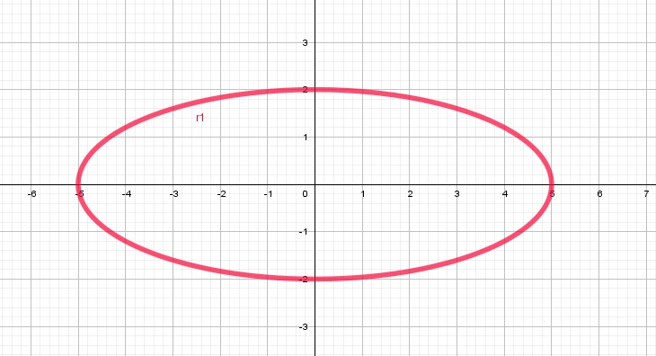
Tasks for students
Find the centre and vertices of the ellipse. Sketch the ellipse.
$$4x^{2}+25y^{2}=100$$
$$\frac{x^{2}}{25}+\frac{y^{2}}{4}=1$$

Slide 12
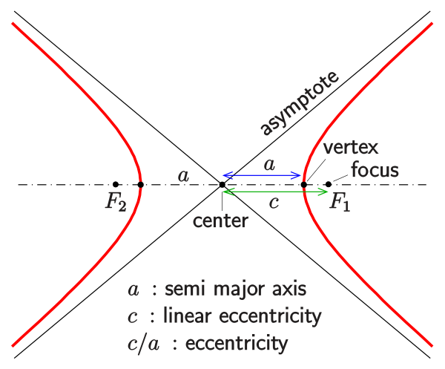
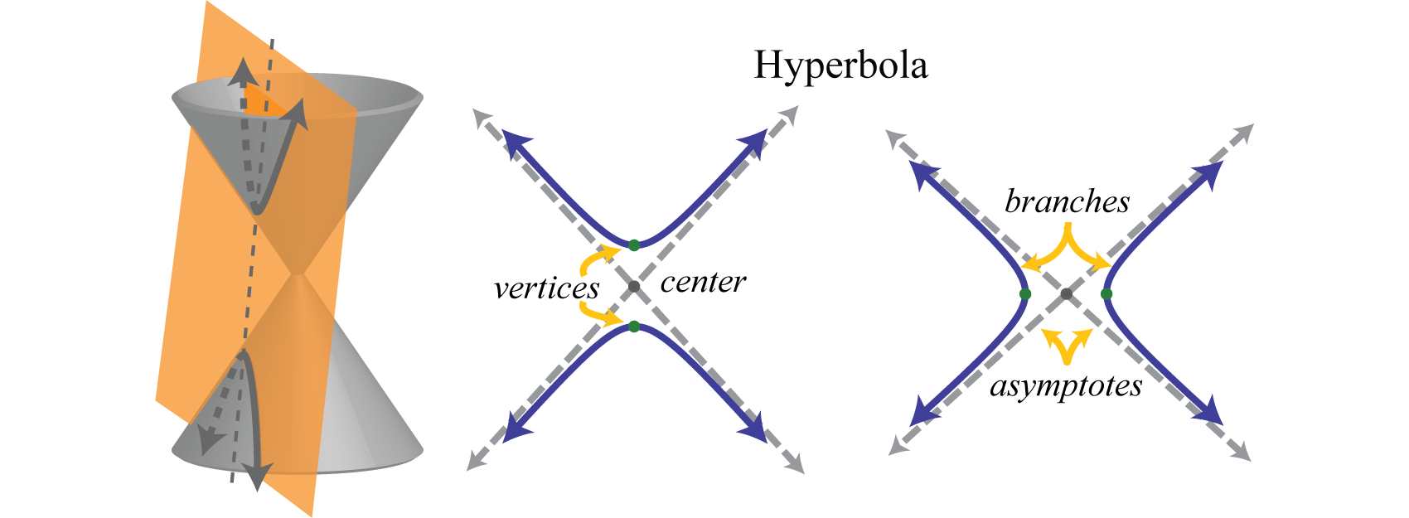
Hyperbola
Hyperbola is a two-branched open curve
Fixed points F1 and F2 are called foci of a hyperbola
The line through the F1 and F2 is the transverse axis and the line through the centre perpendicular to the transverse axis is the conjugate axis.
The points the transverse axis cuts the hyperbola and the vertices
The midpoint of the vertices is the centre of the hyperbola
The two separate parts of the hyperbola are the two branches.
Every hyperbola has two asymptotes which cross the centre of hyperbola. Hyperbola approachs the asymptotes.

Slide 13
Definition of hyperbola

Slide 15
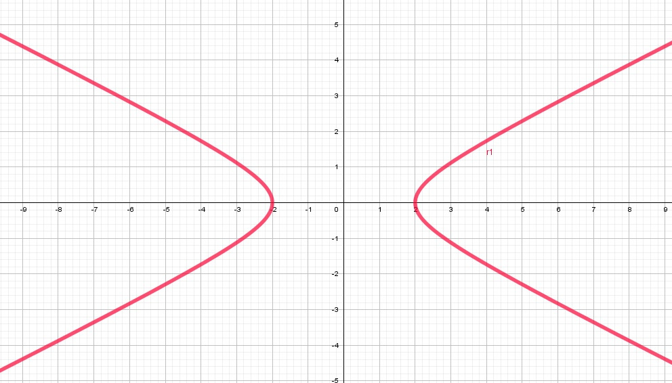
Task for students
Determine equation of a hyperbola given its graph.
Determine equations of asymptotes of this hyperbola.

Slide 16
Task for students
Determine equation of a hyperbola given its graph.
Determine equations of asymptotes of this hyperbola.
$$\frac{x^{2}}{4}−y^{2}=1$$

Slide 17
Task for students
Determine equation of a hyperbola given its graph.
Determine equations of asymptotes of this hyperbola.
$$\frac{x^{2}}{4}−y^{2}=1$$
y =$\frac{1}{2}x$
y = - $\frac{1}{2}x$

Slide 18
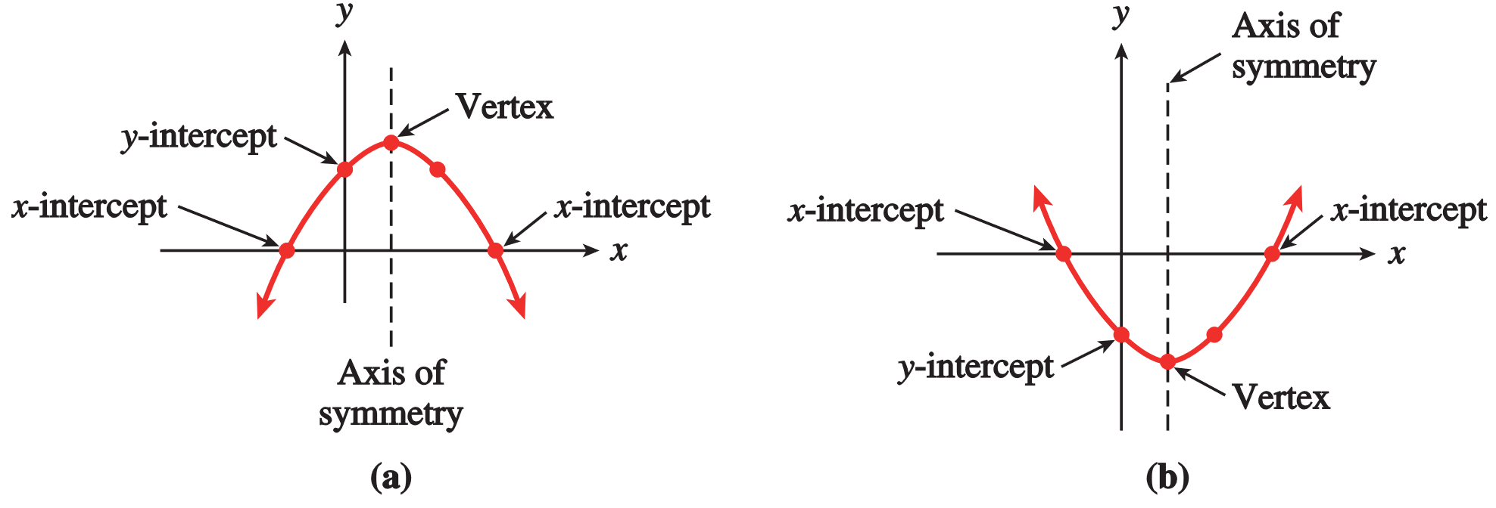
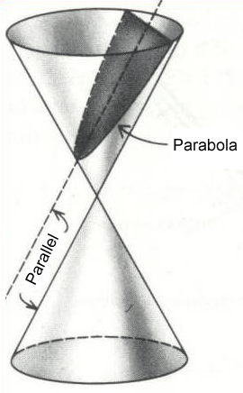
Parabola
Parabola is an open curve. It is the locus of a point that moves in a plane so as to be equidistant from a fixed line and a fixed point.
The fixed line is called the directrix.
The fixed point is called the focus.
The line through the focus perpendicular to the directrix is the axis of the parabola.
The point where the axis cuts the parabola is the vertex. It is possible to take the vertex as the origin.

Slide 19
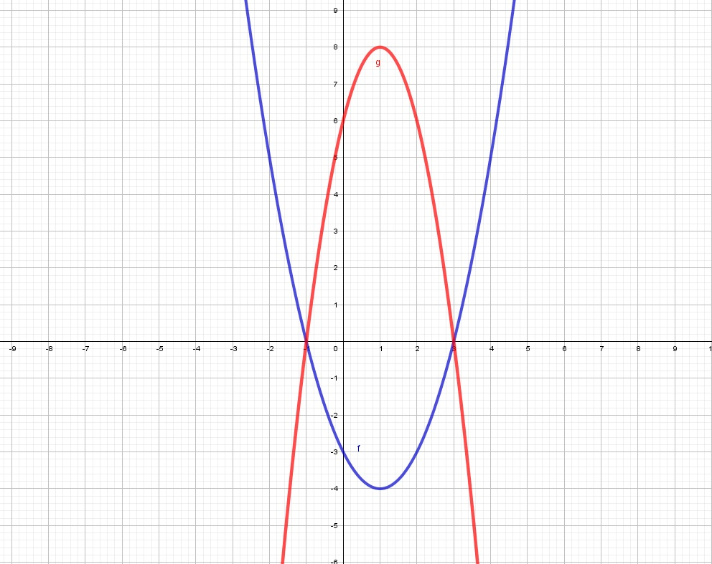
Task for students
Find equations of these parabolas.

Slide 20
Task for students
Find equations of these parabolas.
$$y=\left(x+1\right)\left(x−3\right)$$
$$y=−2(x+1)(x−3)$$
$$A=πr^{2}$$

Slide 21
Task
Find the vertex of parabola $y=x^{2}−2x+5$

Slide 22
Task
Find the vertex of parabola $y=x^{2}−2x+5$
$y=x^{2}−2x+1−1+5$

Slide 23
Task
Find the vertex of parabola $y=x^{2}−2x+5$
$y=x^{2}−2x+1−1+5$
$y={(x−1)}^{2}+4$

Slide 24
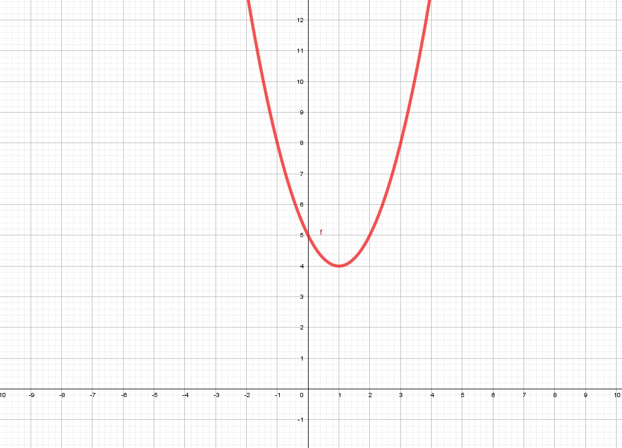
Task
Find the vertex of parabola $y=x^{2}−2x+5$
$y=x^{2}−2x+1−1+5$
$y={(x−1)}^{2}+4$
The vertex is [1;4]

Slide 25
Task for students
Find an equation for the circle with radius 2 and centre at [3; 4].
Find an equation for the parabola which passes through the point [1; 3]. and has vertex at [2; 4].
Find an equation for the hyperbola with centre at [0; 0] such that major axis is paraller to x-axis and the length of major axis is 2 and the length of minor axis is 1.
Find an equation for the ellipse with centre at [-3; 5] such that major axis is paraller to y-axis and the length of major axis is 3 and the length of minor axis is 4.

Slide 26
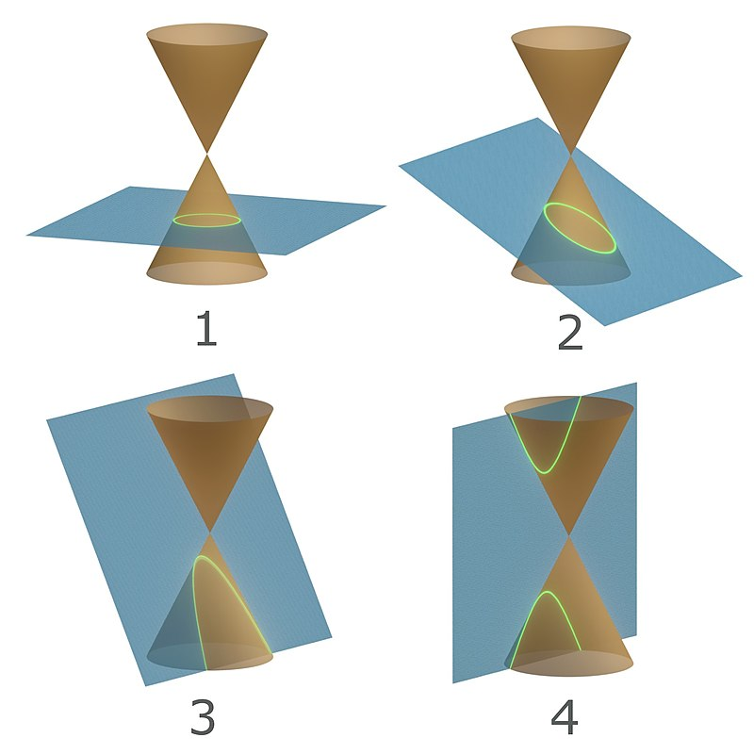
Thank you for attention

